Slide 1


Development of effective cross-linkers and their application in XL-MS
陈红莉
2023-08-31

Slide 2
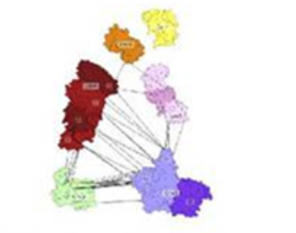
Cross-linking mass spectrometry (XL-MS)
Cross-linker
Provide protein structural information
Study protein-protein interactions (PPI)
Study protein dynamics
Protein-protein interaction
Structural modeling
In vivo PPI network
Chem. Rev. 2022, 122, 7647−7689
Chem. Rev. 2022, 122, 8, 7500–7531
J. Proteome Res. 2021, 20, 78−93

Slide 3
XL-MS workflow
“bottom-up” approach
Cross-linker as a distance constraint
Nat Struct Mol Biol. 2018;25(11):1000-1008

Slide 4
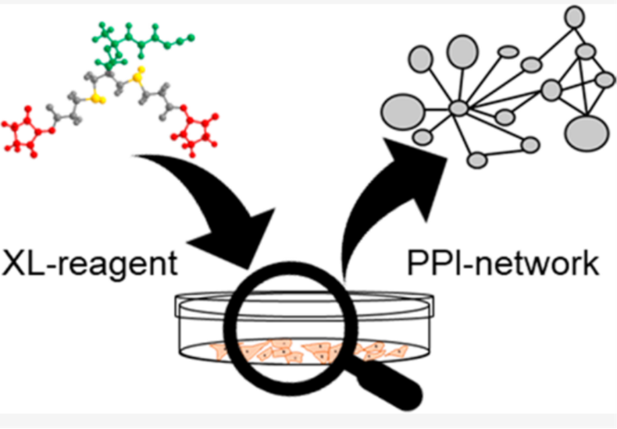
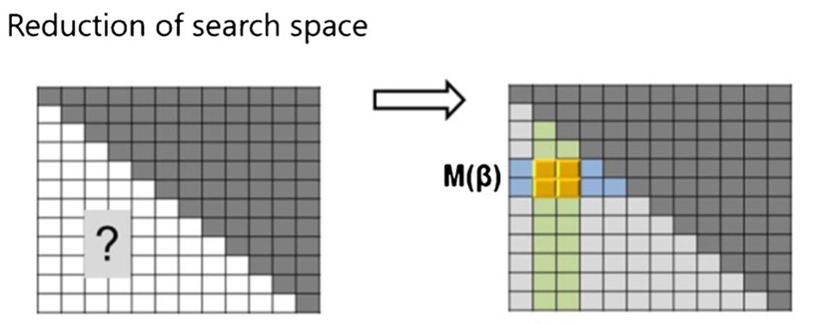
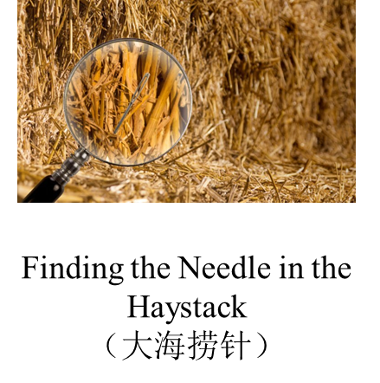
Opportunities and challenges
Challenges:
Major methods (X-ray\ NMR\cryo-EM)
(1). To obtain sufficient amounts of pure compounds;
(2). To identify weak and transient interactions
XL-MS
(1). The n-square problem (large search space)
(2). The presence of large linear peptides
(Low abundance)
Complementary method in addressing biological questions

Slide 5
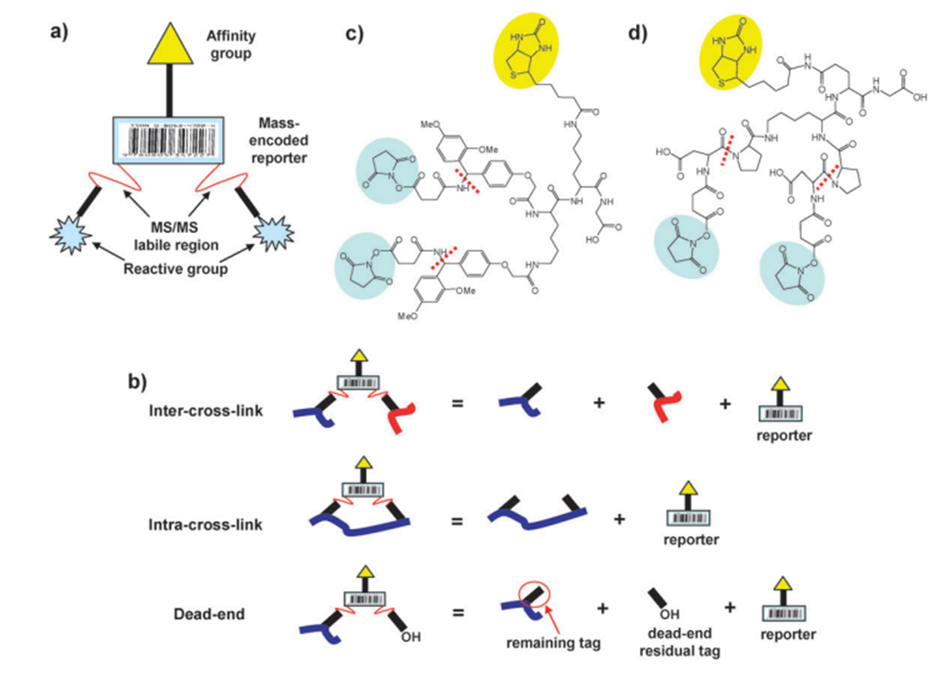
Enrichable cross-linker
Mol. BioSyst., 2010, 6, 939–947
PIR cross-linker
Mol. Cell. Proteomics 2013, 12 (5), 1451−1467

Slide 6
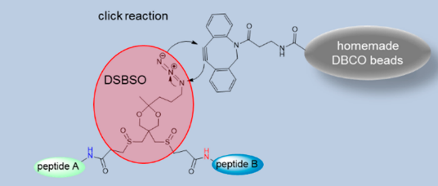
Enrichable cross-linker
Mol. Cell. Proteomics 2014, 13 (12), 3533−3543
J. Proteome Res. 2020, 19, 2071−2079
Org. Biomol. Chem., 2015, 13, 5030
ChemBioChem 2020,21, 103-107

Slide 7
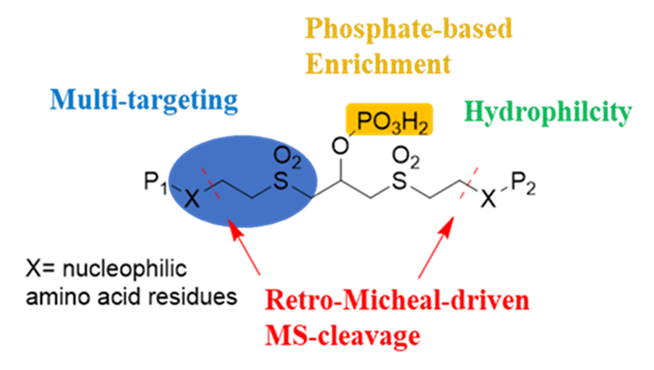
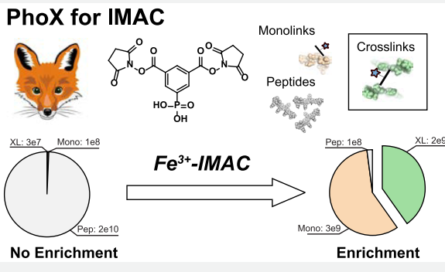
Enrichable cross-linker
H₃PO₄ / (TiO₂)
H₃PO₄ / (IMAC) immobilized metal affinity chromatography enrichment
Received: 21st February 2019
Received: April 23, 2019
Chem Sci. 2019,10(26):6443-6447
ACS Cent Sci . 2019, 5(9):1514-1522

Slide 8
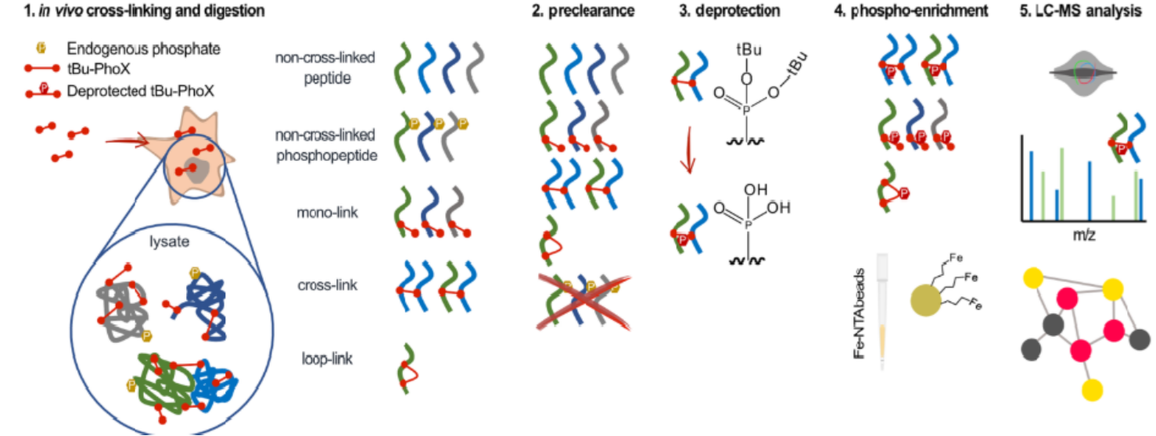
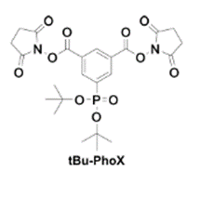
Enrichable cross-linker
A tertiary butyl derivative, membrane permeable
Two-stage IMAC procedure: remove endogenous phosphorylated peptides prior to cross-link enrichment
Angew. Chem. Int. Ed. 2022, 61, e202113937

Slide 9
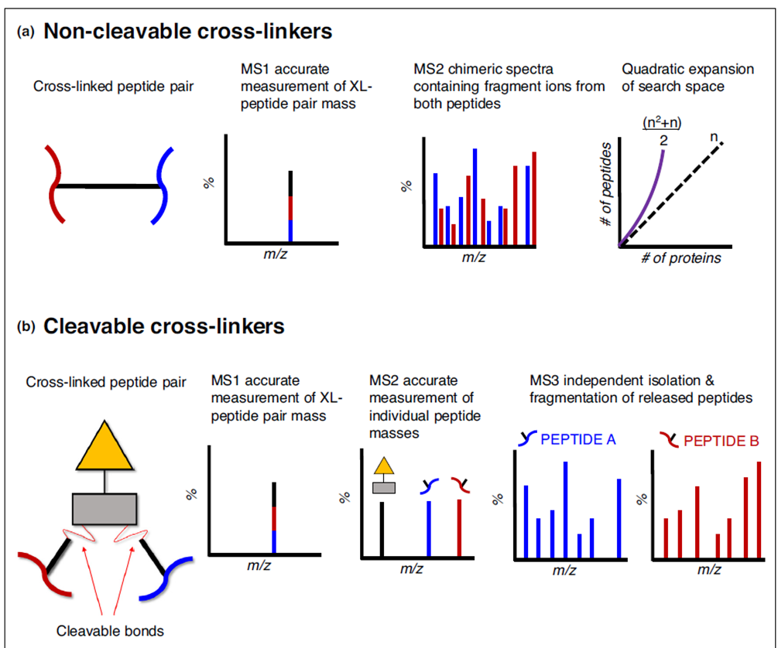
MS-cleavable cross-linker
(n² + n)/2: a quadratic expansion of the search space
An exhaustive combination of all peptides leads to an explosion of the search space
2n: the quadratic search space (n²) can be reduced to a linear search space (2n)
Current Opinion in Chemical Biology 2019, 48:8–18

Slide 10
MS-cleavable cross-linker
Overview of cross-linking reagents applied to biological applications
J. Am. Soc. Mass Spectrom. 2020, 31, 2, 196–206
Unpublished data from 高秀霞，陈文章

Slide 11
Enrichable and MS-cleavable cross-linker
cross-linker
XL-MS moves toward conducting in highly complex biological systems
Increase the identification confidence; Minimize the search space and time.
Phosphate based-Enrichable and MS-cleavable cross-linker
Simplify the workflow
Unpublished data from 高秀霞，陈文章

Slide 12
Linker development and application
Tuning the structure of vinylsulfonamides
Selective N-terminal modification
Selective lysine modification
Org. Biomol. Chem. 2017, 15, 7339 – 7345
Eur. J. Org. Chem. 2018, 829-836.
Selective disulfide modification
Selective cysteine modification
Org. Lett., 2017, 19, 4972–4975
Org. Lett., 2018, This: Org. Lett. 2018, 20, 6526−6529.
Unpublished data from 高秀霞，陈文章

Slide 13
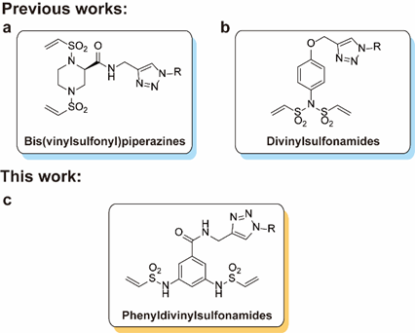
Linker development and application
Thio-bridge technology to construct highly homogeneous DAR 2 and DAR 4 ADCs
Org. Biomol. Chem. 2017, 15, 7339 – 7345.
Org. Lett., 2017, 19, 4972–4975.
Eur. J. Org. Chem. 2018, 829-836.
Org. Lett., 2018, 20 (20), 6526-6529.
Org. Lett., 2019, 21 (11), 4159-4162.
Bioorg. Med. Chem. 2020, 28 (23), 115793.
Eur. J. Med. Chem., 2020, 190, 112080.
Eur. J. Med. Chem., 216, 2021, 113355.
Bioorganic & Medicinal Chemistry 51 (2021) 116497.
Chem Commun (Camb), 2022. 58(72), 10072.
Chin. Chem. Lett., 2023. 34(5), 108091.
Bioorg. Chemistry, 2023. 134, 106463.
Eur. J. Med. Chem., 257, 2023, 115489.
Native antibody modification
Cost-effective and accessible methods
Unpublished data from 高秀霞，陈文章

Slide 14
Linker development and application
Phosphate-based enrichable and Multi-targeting
Chem Sci. 2019,10(26):6443-6447

Slide 15
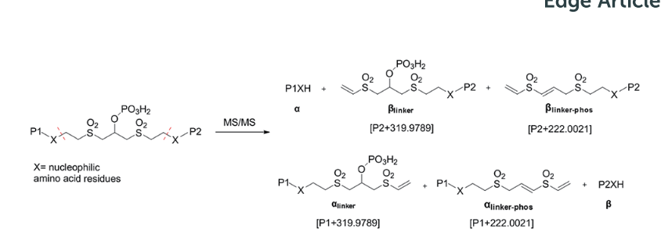
Linker development and application
MS-cleavable: through retro-Michael addition
Chem Sci. 2019,10(26):6443-6447

Slide 16
Linker development and application
A total of 49 unique cross-linked peptides, including 27 Lys–Lys, 20 Lys–His and 2 His–His, were detected by LC/MS/MS analysis from BSA
Chem Sci. 2019,10(26):6443-6447

Slide 17
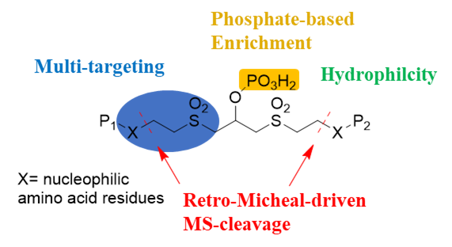
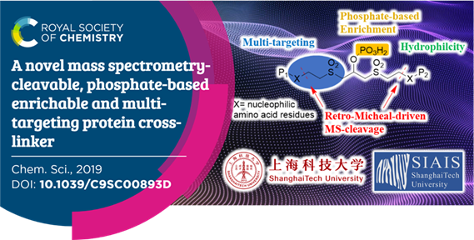
Linker development and application
Multi-targeting----react with several nucleophilic residues by Michael addition
MS-cleavable----MS-cleavage through retro-Michael addition
Enrichable----selectively enrich cross-linked peptides using the TiO₂/IMAC method
Limitations
Efficiency; Stability
Chem Sci. 2019,10(26):6443-6447
Unpublished data from 高秀霞，陈文章

Slide 18
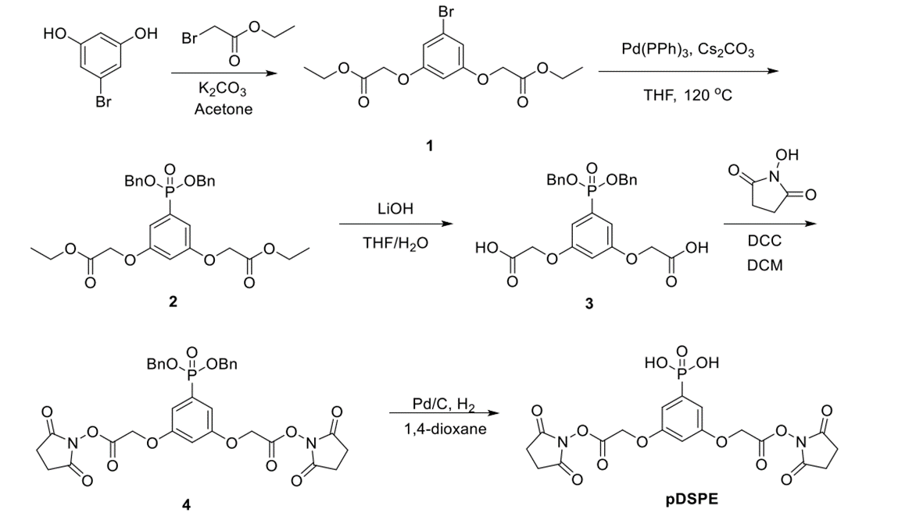
Linker development and application
Stable C-P bond
Phenoxyl ether bond
Anal Chem 2020, 92 (20), 13702-13710

Slide 19
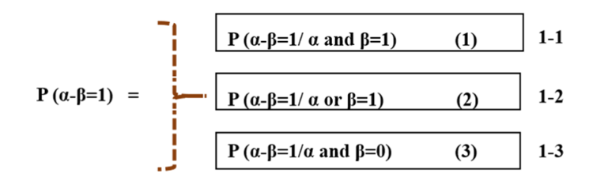

Linker development and application
Cross-linked peptides
Mono-linked peptides
Linear peptides
Both the mono linked peptides α and β detected
Mono-linked peptide required
One of the mono linked peptides α a or β detected
None of the mono linked peptides α a or β detected
Restricted search space
Mono-linked peptides (type 0) DB
Decision tree searching strategy (DTSS)
Anal Chem 2020, 92 (20), 13702-13710
Unpublished data from 高秀霞，陈文章

Slide 20
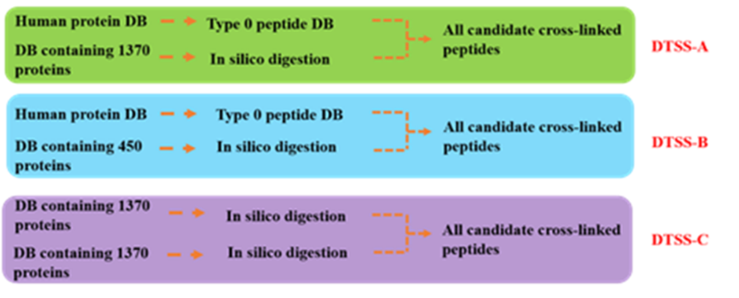

Linker development and application
Restricted search space
Mono-linked (type 0) peptides DB
Reducing the search space to 1/40
Restricted search
Unrestricted search
Three different search workflows
Concern: Decreasing search space The loss of useful data
Anal Chem 2020, 92 (20), 13702-13710
Unpublished data from 高秀霞，陈文章

Slide 21
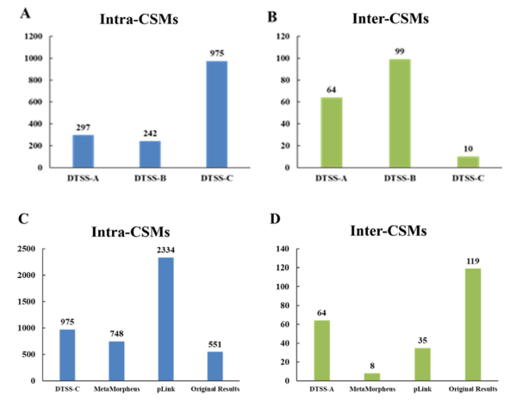
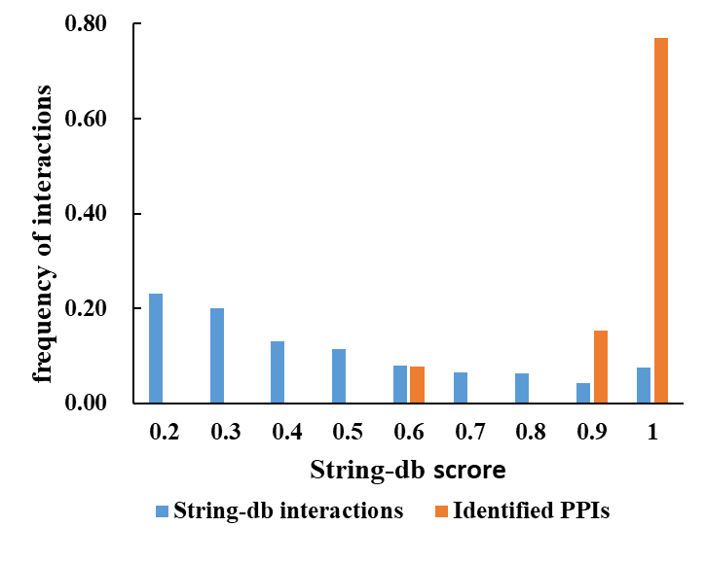
Linker development and application
The distribution of STRING database scores
DTSS led to the loss of intra-CSMs; Searching sensitivity was significantly increased for inter-CSMs (64:10); DTSS was more sensitive than the existing approaches (MetaMorpheus (8) and pLink 2 (35)); The identified PPIs are reliable .
Anal Chem 2020, 92 (20), 13702-13710

Slide 22
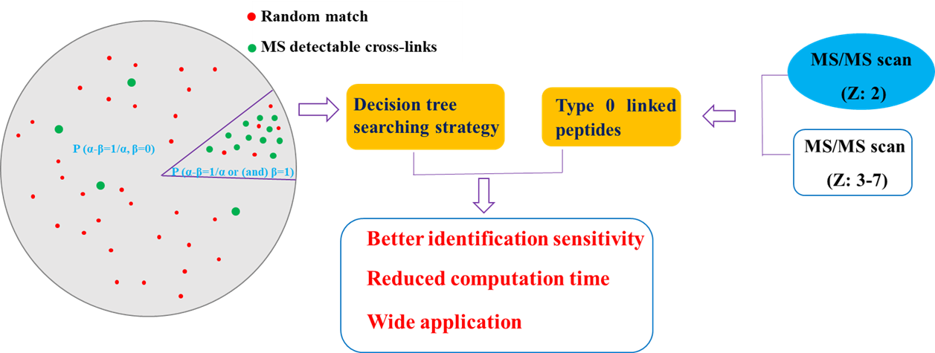
Linker development and application
Decision tree searching strategy (DTSS)
Highly sensitive for the identification of inter-cross-linked peptides
Anal Chem 2020, 92 (20), 13702-13710

Slide 23
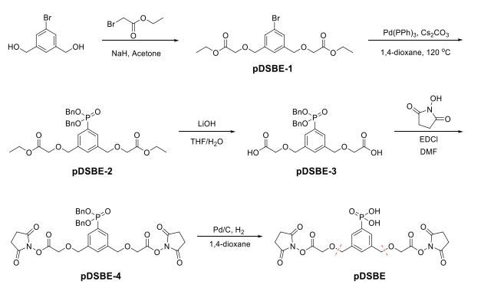
Linker development and application
Stable C-P bond
Benzyl ether bond
J Am Soc Mass Spectrom 2021, 32 (9), 2410-2416.
Unpublished data from 高秀霞，陈文章

Slide 24
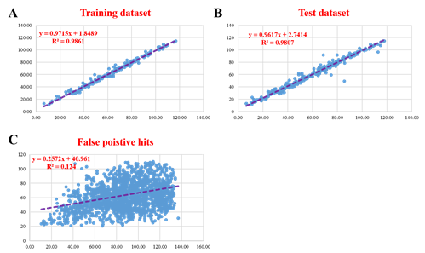
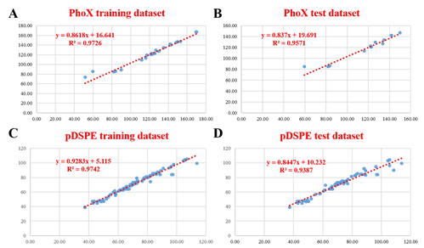
Linker development and application
R²=0.98
R²=0.1
A high correlation of RT was obtained;
The prediction method is reliable for published data set.
J Am Soc Mass Spectrom 2021, 32 (9), 2410-2416.

Slide 25
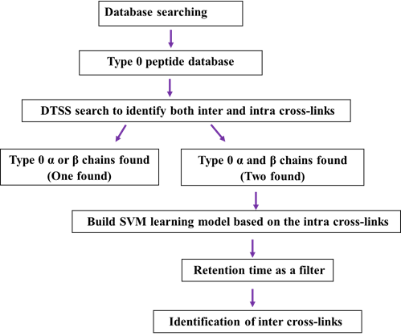
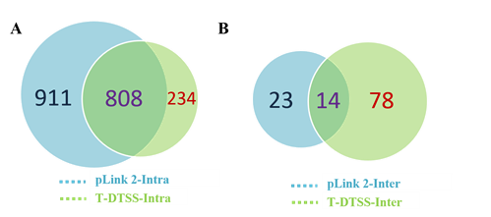
Linker development and application
Remove the majority of false positive hits;
Facilitate the increase of inter-cross-link identification;
92 vs 37 inter-CSMs (compared with pLink 2)
RT used as an extra filter;
Combined with DTSS.
J Am Soc Mass Spectrom 2021, 32 (9), 2410-2416.

Slide 26
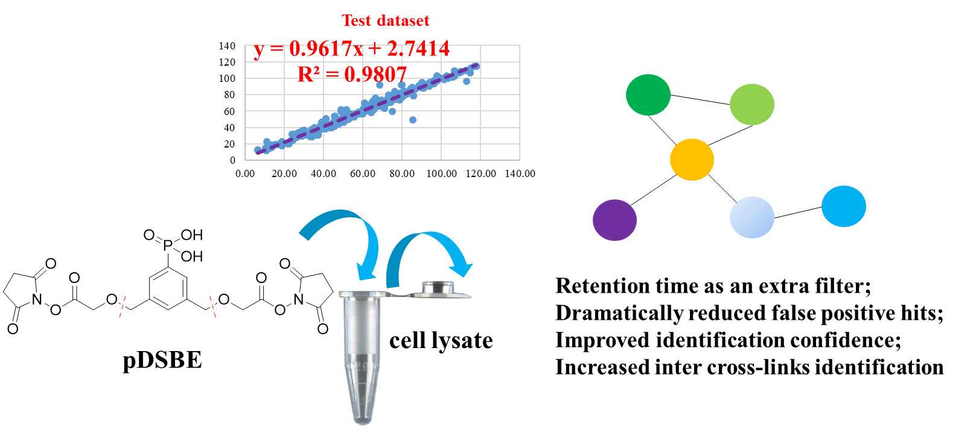
Linker development and application
RT-DTSS strategy
Reduce search space, remove false positive hits and improve identification confidence
J Am Soc Mass Spectrom 2021, 32 (9), 2410-2416.

Slide 27
Linker development and application
Compound | Time (h) | Temperature | pH | Coupling Number
7 | 12 | 37 ºC | 7.4 | 9.29
8 | 12 | 37 ºC | 7.4 | 7.07
9 | 12 | 37 ºC | 7.4 | 0.34
10 | 12 | 37 ºC | 7.4 | 0.29
11 | 12 | 37 ºC | 7.4 | 0.41
12 | 12 | 37 ºC | 7.4 | 0.66
13 | 12 | 37 ºC | 7.4 | 2.98
14 | 12 | 25 ºC | 7.4 | 2.89
15 | 12 | 37 ºC | 7.4 | 1.07
16 | 12 | 37 ºC | 7.4 | 12.11
17 | 12 | 37 ºC | 7.4 | 0
Unpublished data

Slide 28
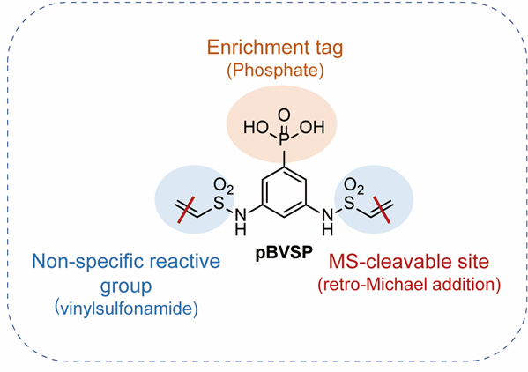
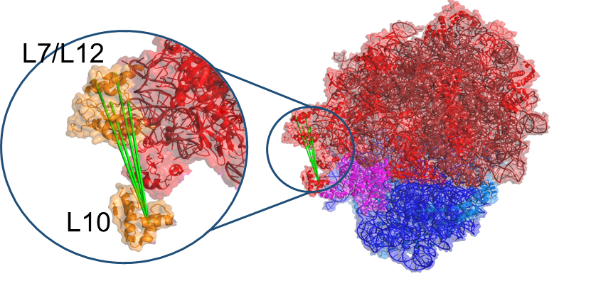
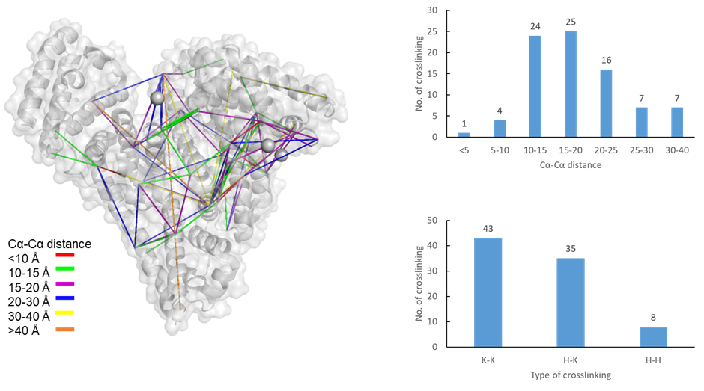
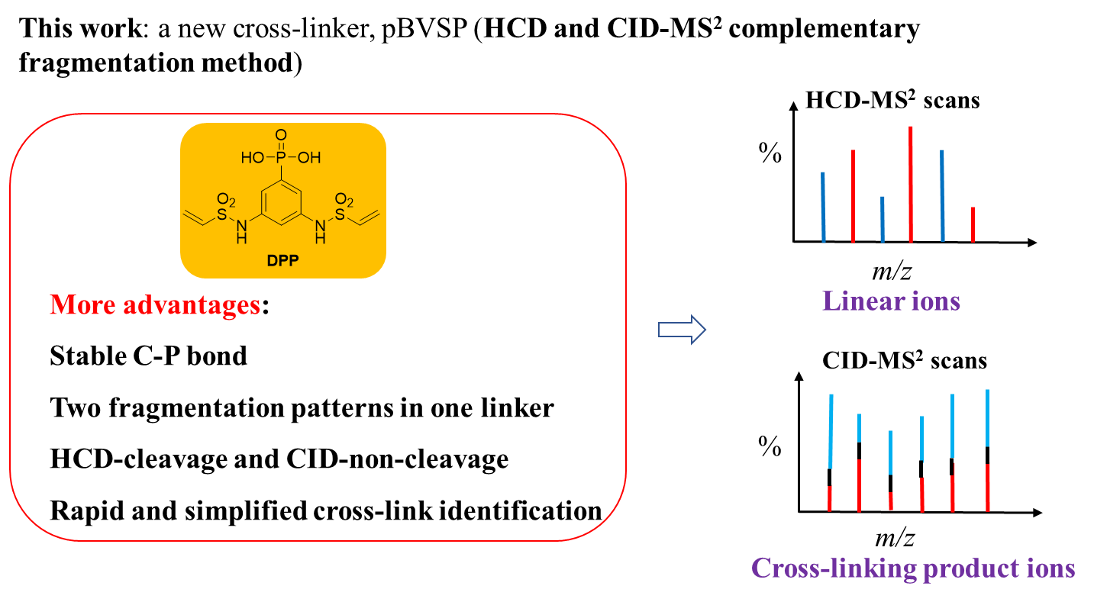
Linker development and application
MS-cleavable and enrichable
Application in complex cell lysate
Two fragmentation patterns in one linker
Unpublished data

Slide 29
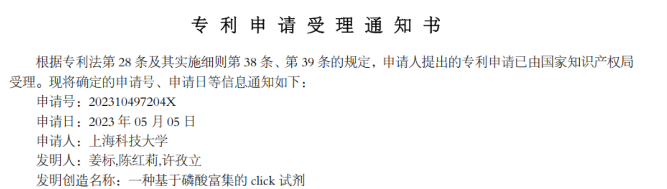
Linker development and application
A hetero-cross-linker; Phosphate-based click reagents;
460 cross-linked pairs identified; Engaging all residue types
Unpublished data

Slide 30
Summary
A phosphate-based enrichable, MS-cleavable and multi-targeting protein cross-linker has been developed; Retro-Michael addition mediated MS- fragmentation;
An decision tree searching strategy (DTSS) has been proposed to reduce search space and boost the identification of inter cross-linked peptides;
RT prediction method to remove false positive hits and improve identification confidence.
New linkers with special fragmentation patterns;
Phosphate-based click reagents for enrichment.
Unpublished data from 高秀霞，陈文章

Slide 31


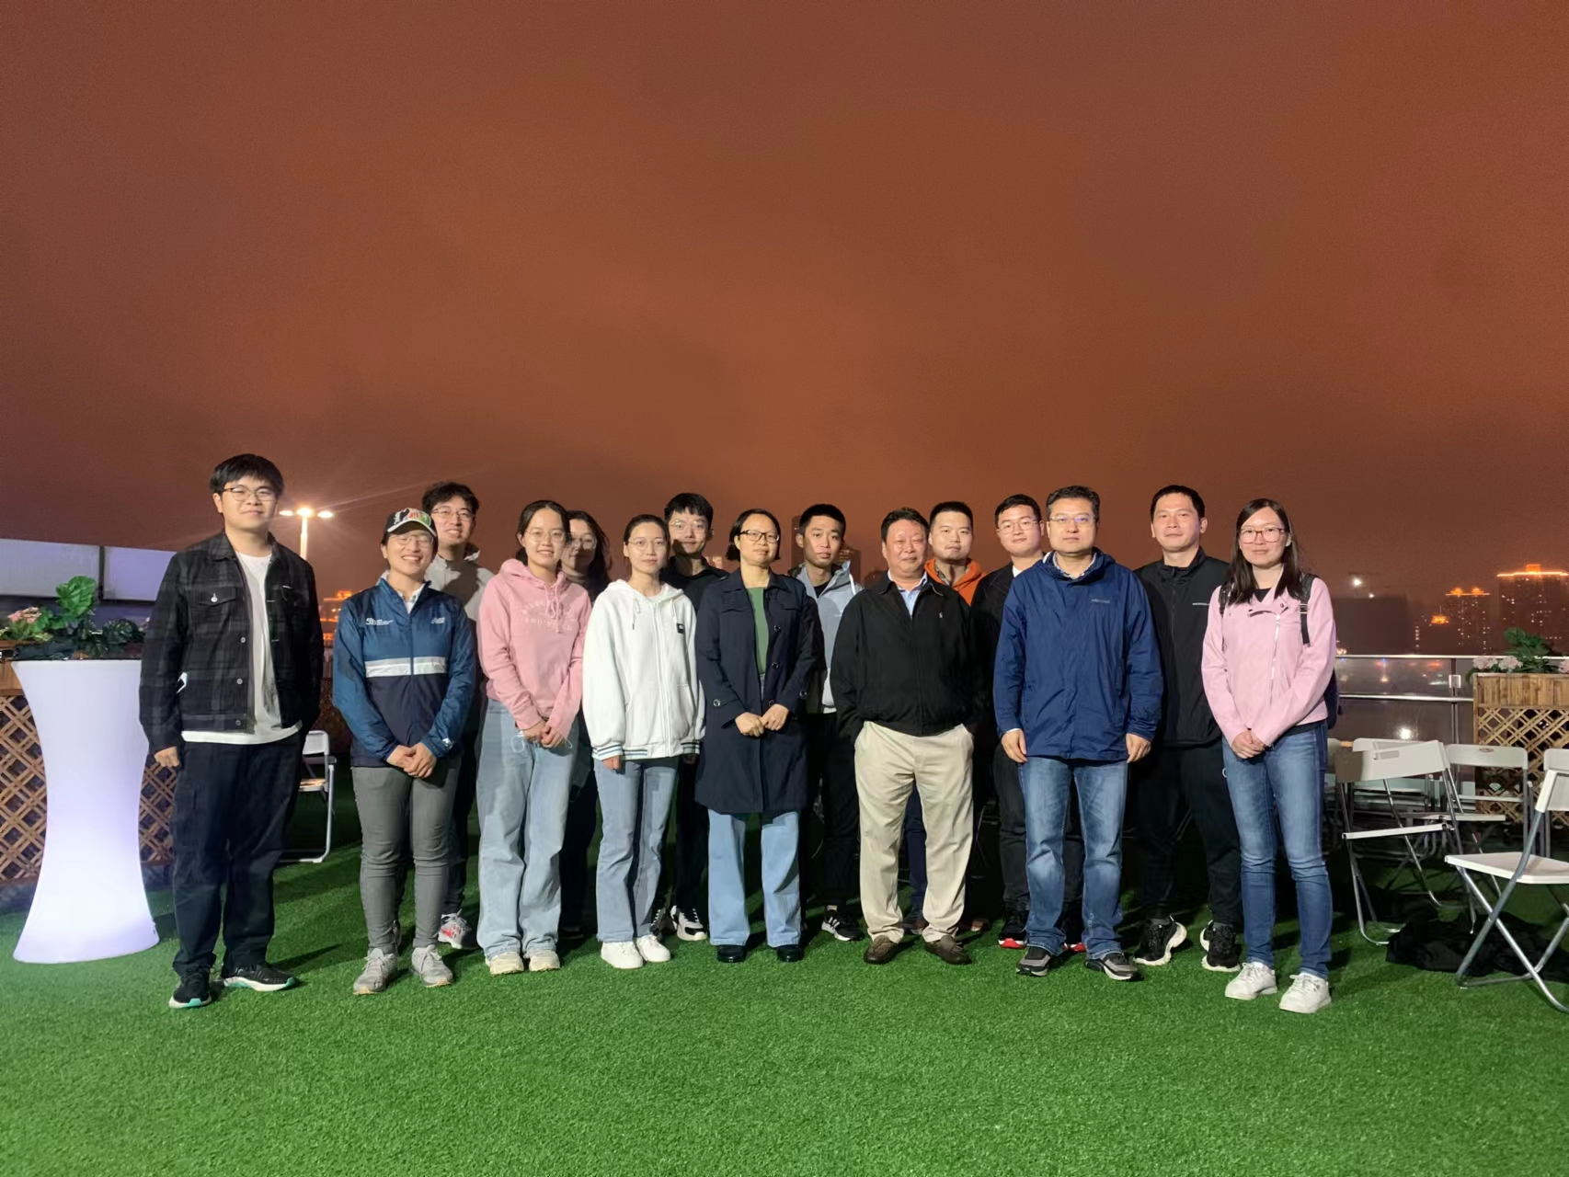
Acknowledgements

Slide 32


